Slide 1
TROJAN MAP
EE 538 - FINAL PROJECT

Slide 2
OUTLINE
Self-Implementation
Auto Complete Name / Closest name / Find Location
Bellman Ford Shortest Path
Dijsktra Shortest Path
Cycle Detection
Topological Sort
Travelling Salesman Problem
Find Nearby

Slide 3
SELF-IMPLEMENTATION

Slide 4
Given names, find their location information.
Using Binary Search !!!
Time: O(logn)
Space: O(n)
<Location Name 1>
<Node Info 1>
<Location Name 2>
<Node Info 2>
<…>
<…>
<Location Name n>
<Node Info n>

Slide 5
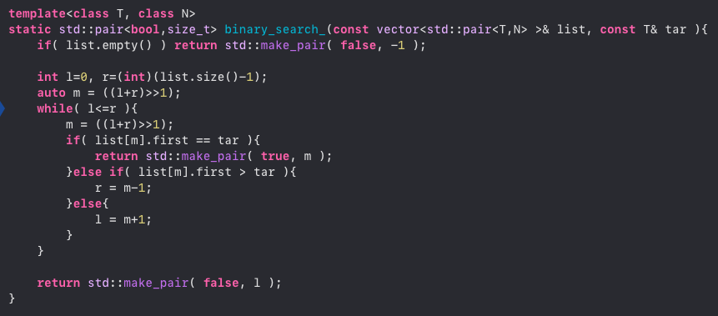
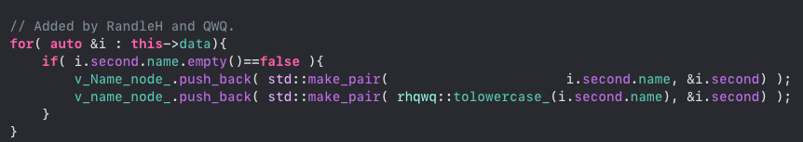
Given names, find their location information.
Using Binary Search !!!
Step 1: Find the node that has a valid name.
Step 2: Sort the array of name first.
Step 3: Apply binary search
Step 4: If the name doesn’t exist, find the nearest one (The one you will insert the name before that).

Slide 6
The following functions all used Binary Search !!!
std::string GetID(const std::string& name);
std::vector<std::string> Autocomplete(std::string name);
std::pair<double, double> GetPosition(std::string name);
std::string FindClosestName(std::string name);
std::vector<std::string> CalculateShortestPath_Dijkstra
(std::string location1_name, std::string location2_name);
std::vector<std::string> CalculateShortestPath_Bellman_Ford
(std::string location1_name, std::string location2_name);

Slide 7
OUTLINE
Self-Implementation
Auto Complete Name / Closest name / Find Location
Bellman Ford Shortest Path
Dijsktra Shortest Path
Cycle Detection
Topological Sort
Travelling Salesman Problem
Find Nearby

Slide 8
AUTO-COMPLETE & FIND LOCATION

Slide 9

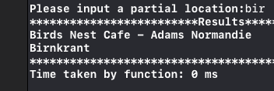
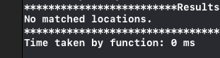
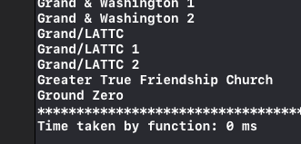
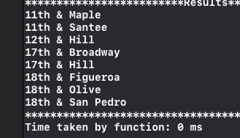
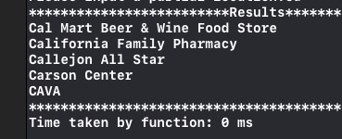
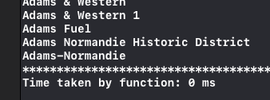
AUTO-COMPLETE
Here are some results for auto-completetion.
Time: O(logn)
Input: ”bir”
Input: ”yu”
Input: ”g”
Input: ”1”
Input: ”Ca”
Input: ”Ada”

Slide 10
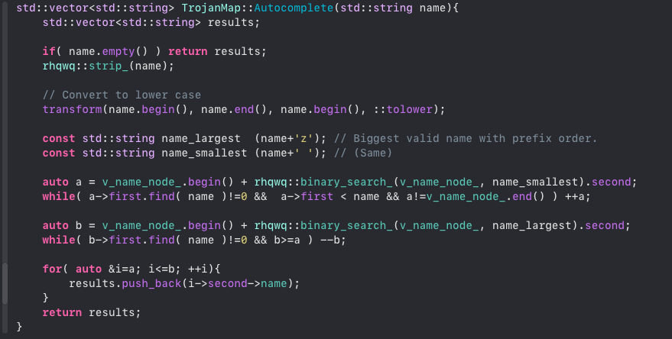
AUTO-COMPLETE

Slide 11
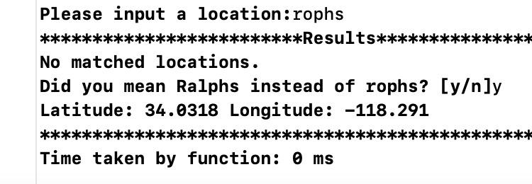
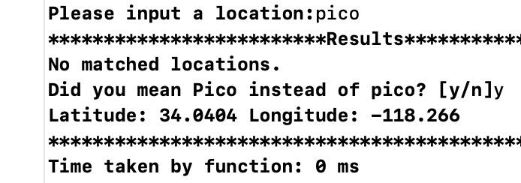
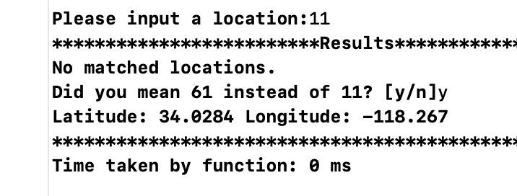
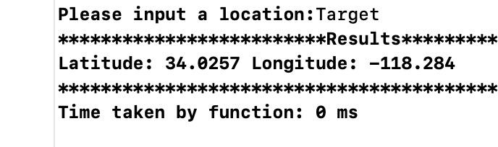
FIND LOCATION
Here are some results for finding a location.
Time: O(logn)
Input: ”rophs”
Input: ”pico”
wrong name
process
Input: ”11”
Input: ”Target”

Slide 12
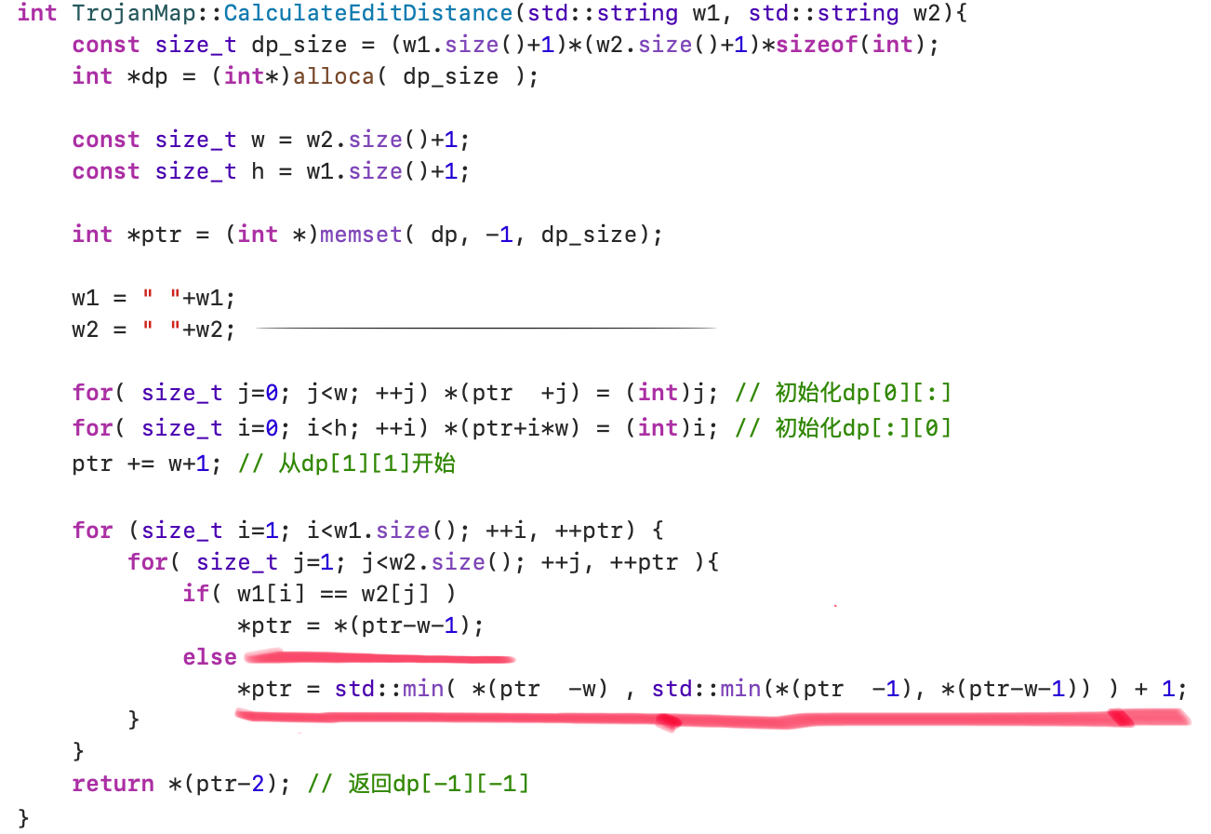
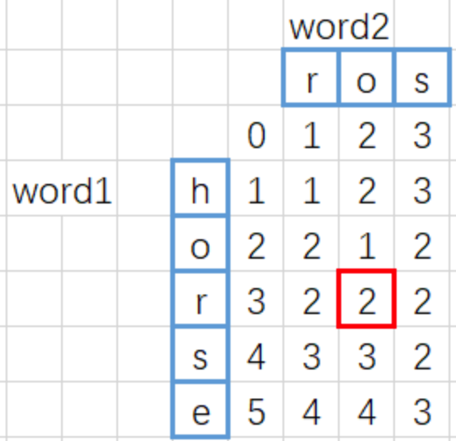
EditDistance
CalculateEditDistance(),time complexity: O(n²)
Dynamic Programming by pointer
If word1[i]==word2[j]:
D[i][j]=1+min(D[i-1][j],D[i][j-1],D[i-1][j-1]-1)
if word1[i]!=word2[j]:
D[i][j]=1+min(D[i-1][j],D[i][j-1],D[i-1][j-1])
Final edit distance

Slide 13
OUTLINE
Self-Implementation
Auto Complete Name / Closest name / Find Location
Bellman Ford Shortest Path
Dijsktra Shortest Path
Cycle Detection
Topological Sort
Travelling Salesman Problem
Find Nearby

Slide 14
BELLMAN-FORD

Slide 15
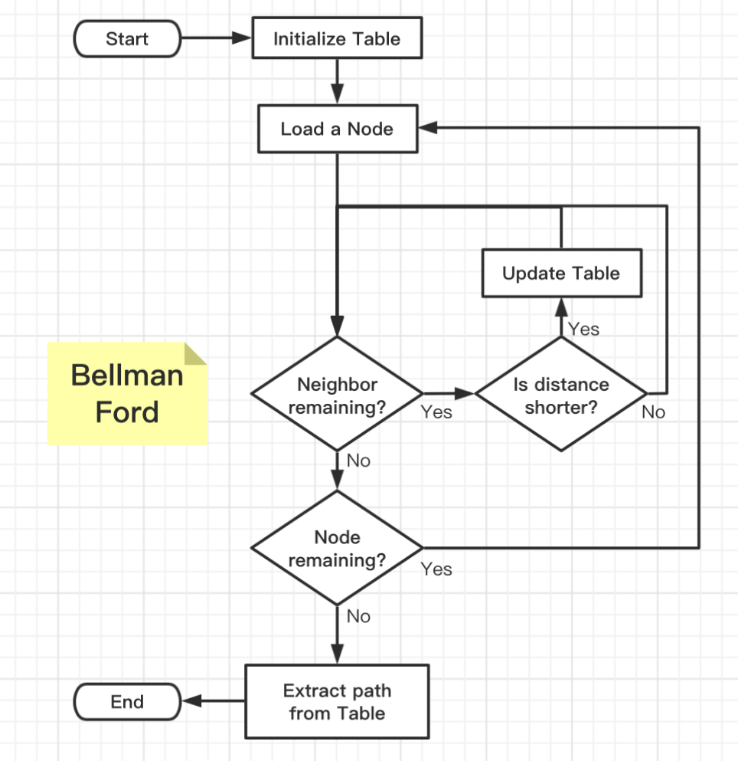

BELLMAN-FORD
What is the Table?
Good searching method
Store distance information
Store node information
How to initialize the Table?
Set all the other nodes to INFINITY
Set the start node distance to 0
Optimization
When to update the Table?
When encounter a node that distance is smaller than stored.
How to know distance is shorter?
Calculate the distance to neighbor
Add current node distance away from root
Compare to the neighbor distance

Slide 16
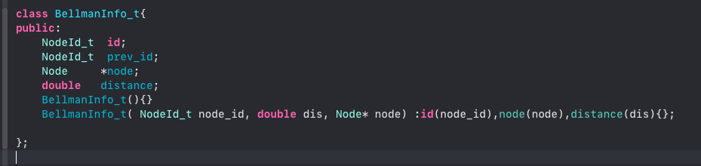
BELLMAN-FORD
Here is the data structure that used to store information for each node.
We view this as a unit stored in our table. The key combined with this unit is the id of the specific node. Therefore we use map to impliment out table.

Slide 17
BELLMAN-FORD
Optimization:
No need to iterate all the node
Stop when no other distance updated
Starting from the node that previously updated
How?
A data structure can store information as the order we proceed
A data structure can pop out the previous data as we go further
A data structure can perform in the way of first in first out.
We use queue!!!
When update a node, put it into the queue.
When iterate a node, pop one from the queue.
The queue always store the data that is updated from the previous iteration.
When the queue is empty, we stop. Because no additional node is updated.

Slide 18
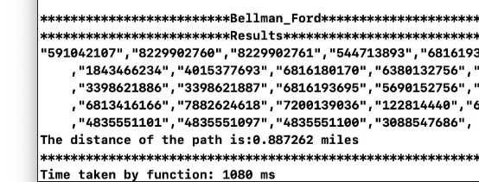
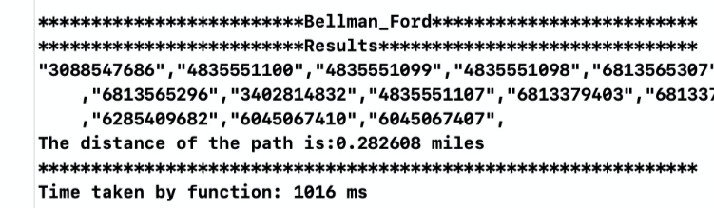
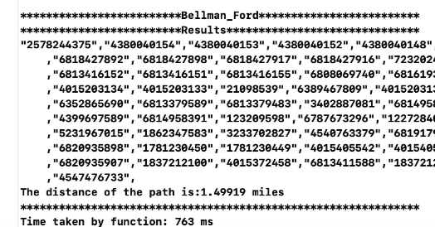
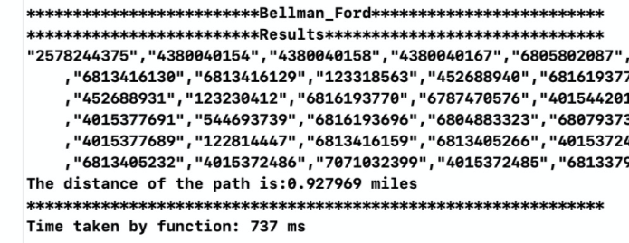
BELLMAN-FORD
Here are some results for Bellman-Ford algorithm.
Time: O(VE)
Start location: ’Arco’
Destination: ‘KFC’
Start location: ’KFC’
Destination: ‘USC Parking’
Start location: ’Ralphs’
Destination: ‘Chick-fil-A’
Start location: ’Ralphs’
Destination: ‘Target’

Slide 19
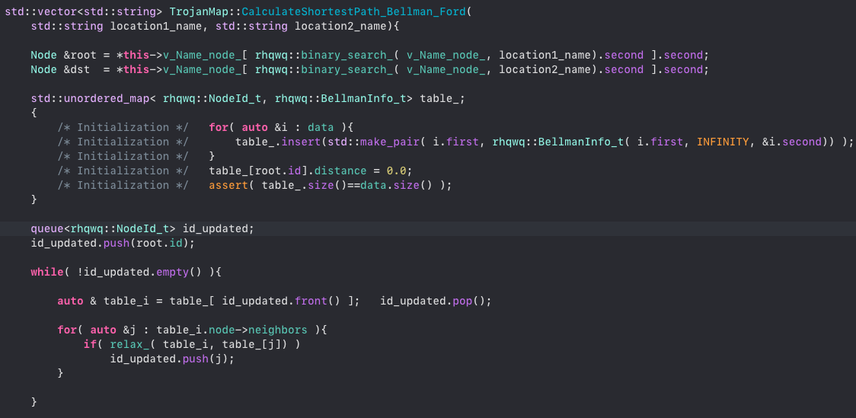
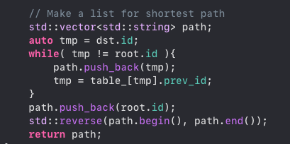
BELLMAN-FORD

Slide 20
OUTLINE
Self-Implementation
Auto Complete Name / Closest name / Find Location
Bellman Ford Shortest Path
Dijsktra Shortest Path
Cycle Detection
Topological Sort
Travelling Salesman Problem
Find Nearby

Slide 21
DIJKSTRA

Slide 22
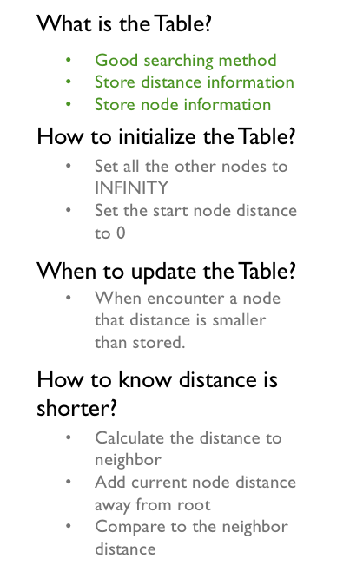
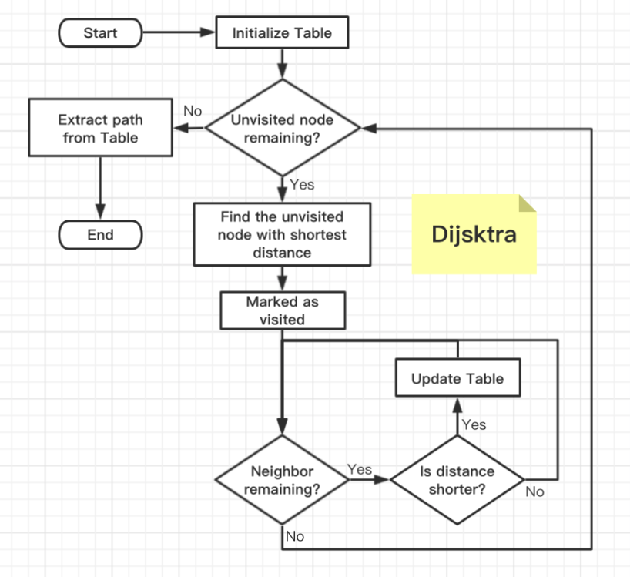
DIJKSTRA
Similar with Bellman Ford
How to find the unvisited node with shortest distance?
Use priority queue!!!

Slide 23
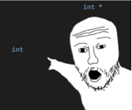
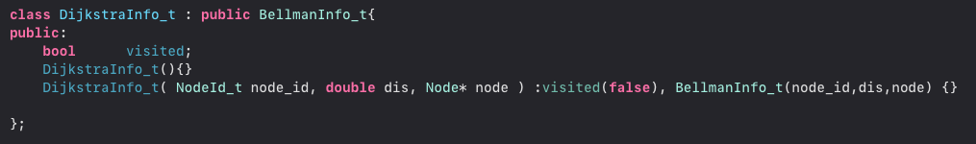
DIJKSTRA
Here is the data structure that used to store information for each node.
Simply inherit from Bellman-Ford
We need a boolean flag to mark visited node.
Again, we view this as a unit stored in our table. The key combined with this unit is the id of the specific node. Therefore we use map to impliment out table.

Slide 24
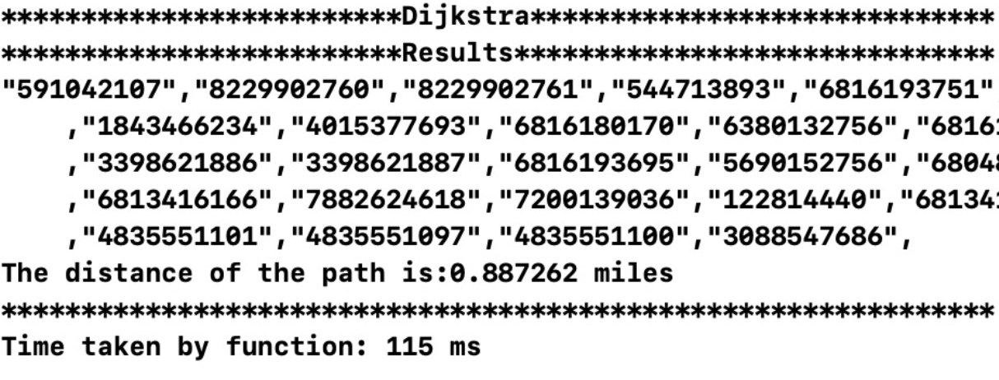
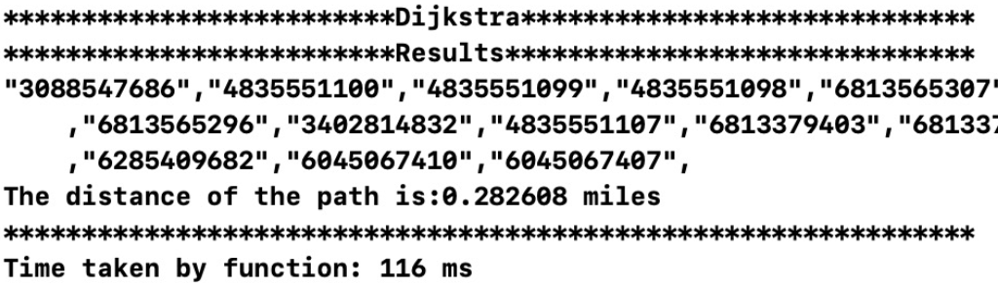
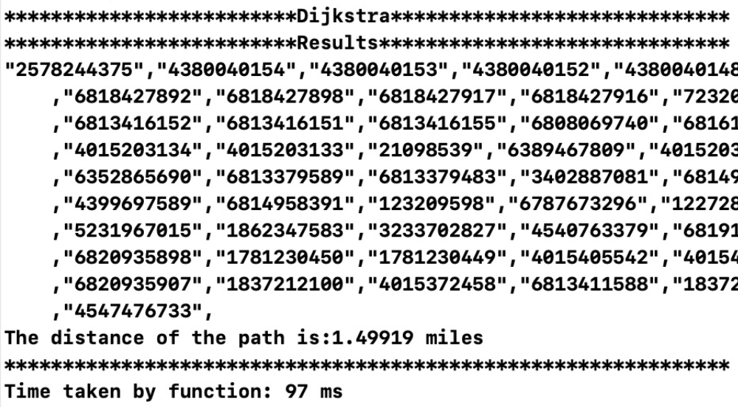
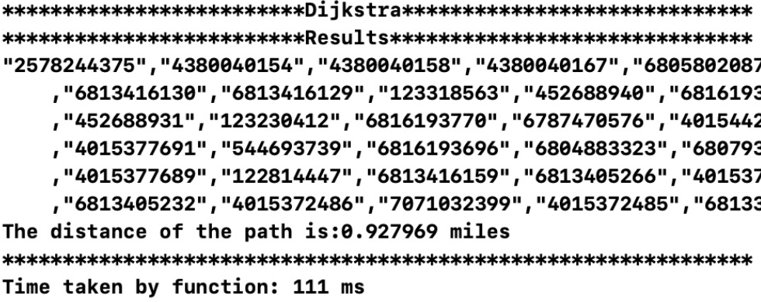
DIJKSTRA
Here are some results for Dijkstra algorithm.
Time: O((V+E)log V)
Start location: ’Arco’
Destination: ‘KFC’
Start location: ’KFC’
Destination: ‘USC Parking’
Start location: ’Ralphs’
Destination: ‘Chick-fil-A’
Start location: ’Ralphs’
Destination: ‘Target’

Slide 25
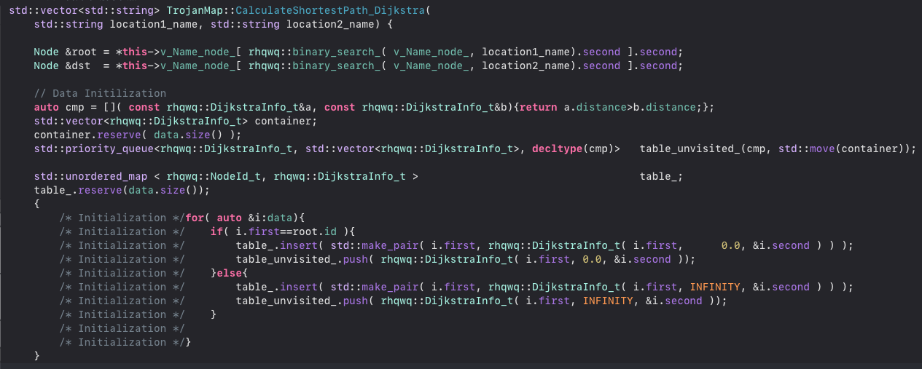
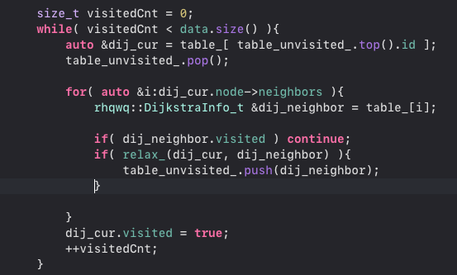
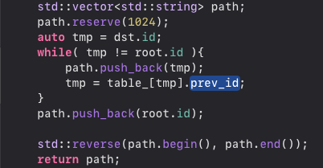
DIJKSTRA

Slide 26
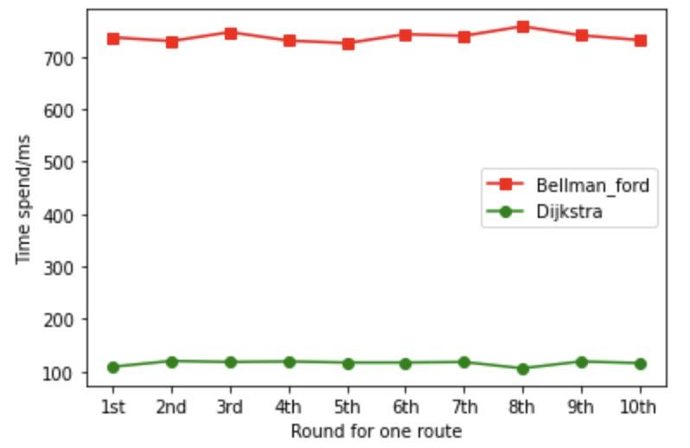
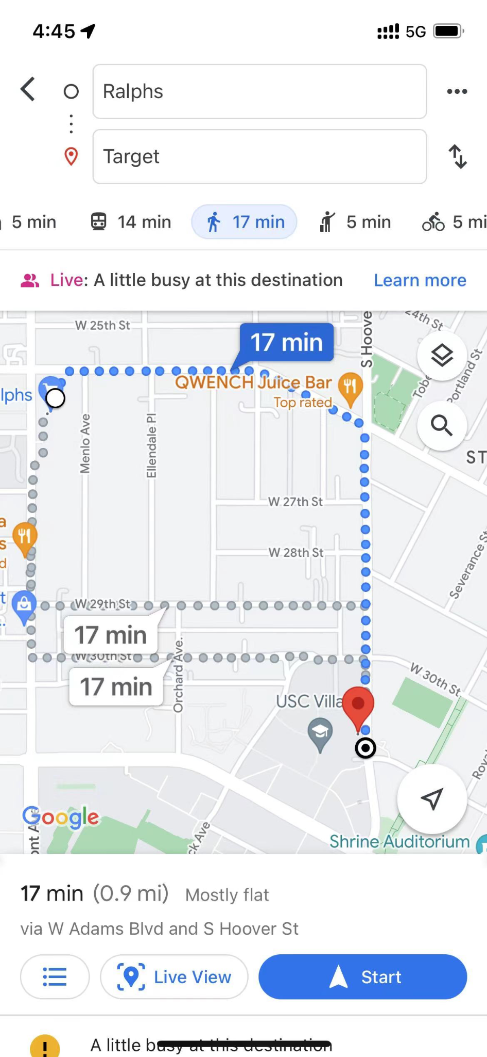
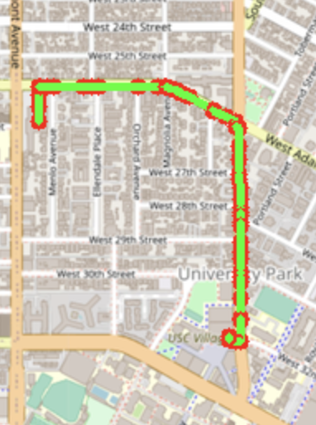
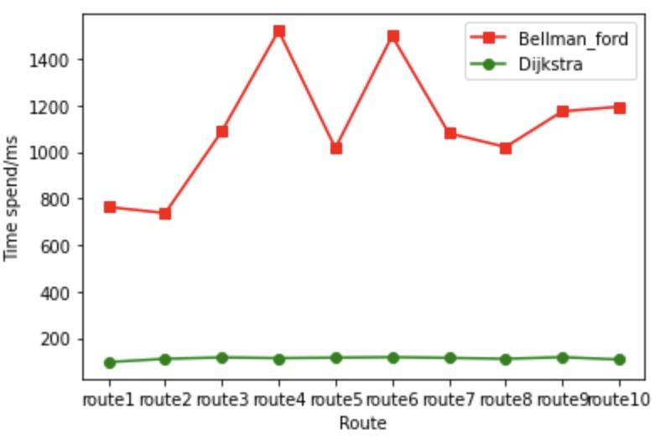
Comparison for Dijkstra and Bellman_Ford
Time spend for one route
Time spend for 10 routes

Slide 27
OUTLINE
Self-Implementation
Auto Complete Name / Closest name / Find Location
Bellman Ford Shortest Path
Dijsktra Shortest Path
Cycle Detection
Topological Sort
Travelling Salesman Problem
Find Nearby

Slide 28
Cycle
Detection

Slide 29
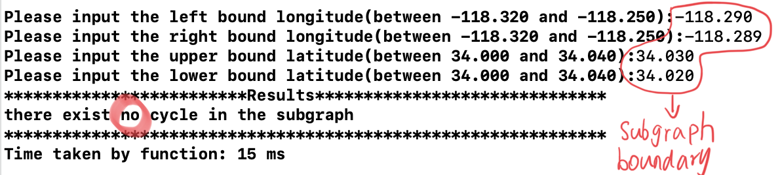
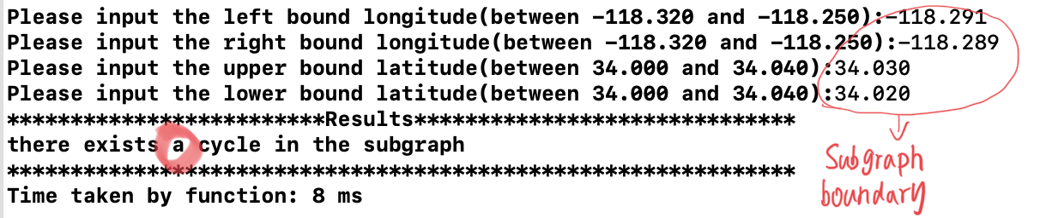
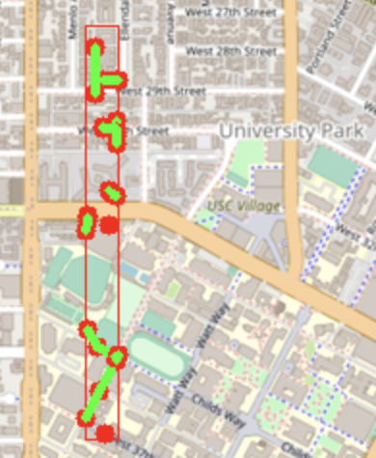
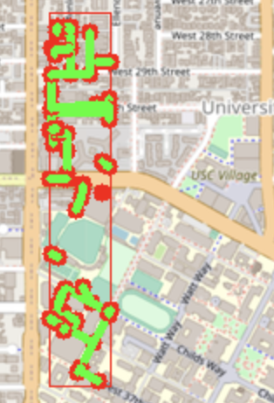
Cycle Detection
Time: O(n)
Check the existence for a cycle path in a subgraph
Use DFS to traverse all the nodes and return true if a neighbour has been visited twice (except parents) AKA back edges!!!
Green line is the edge for the neighbors
A cycle detected!
No cycle

Slide 30
OUTLINE
Self-Implementation
Auto Complete Name / Closest name / Find Location
Bellman Ford Shortest Path
Dijsktra Shortest Path
Cycle Detection
Topological Sort
Travelling Salesman Problem
Find Nearby

Slide 31
cycle detection(comparison example)
topological sort(more complex result,5+dependency)
dij-bellman comparison to each other and google map
arrow on ppt to mention something important

Slide 32
Topological
Sort

Slide 33
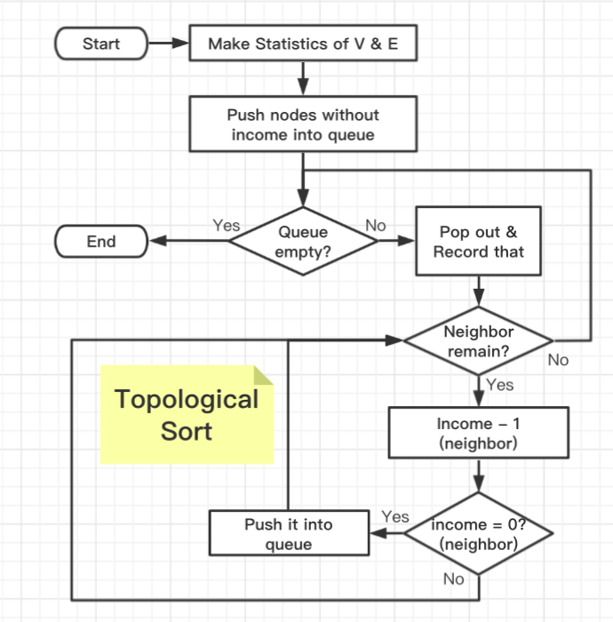
TOPOLOGICAL SORT
Why Queue ?
Breath First Search the graph
First in first out
Why Table ?
Find its node information quickly
Optimization
Push the node into queue while doing the process
Reduce neighbor’s income is the only fact cause it to zero.
Check
If the result number doesn’t match with number of nodes, there exists loop.
Optimization

Slide 34
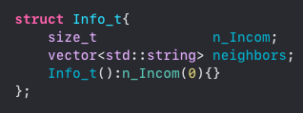
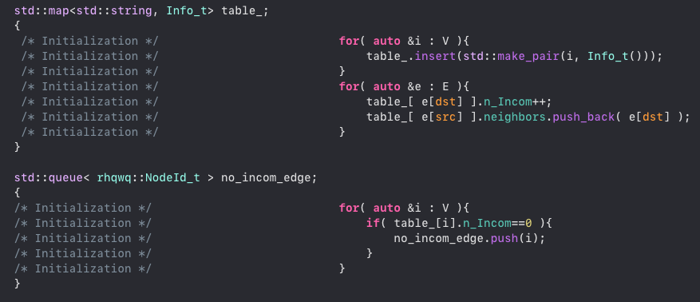
TOPOLOGICAL SORT
Initialization
Translate V and E.
Package (encapsulation)
Summarize things we need for each node

Slide 35
TOPOLOGICAL SORT QWQ
Here are some results for Topological Sort.
Time: O(VE)

Slide 36
OUTLINE
Self-Implementation
Auto Complete Name / Closest name / Find Location
Bellman Ford Shortest Path
Dijsktra Shortest Path
Cycle Detection
Topological Sort
Travelling Salesman Problem
Find Nearby

Slide 37
TRAVELLING SALESMAN

Slide 38
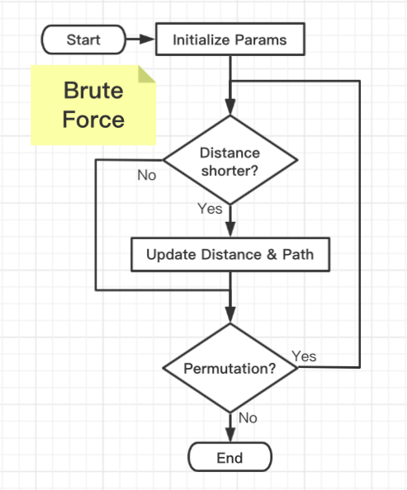
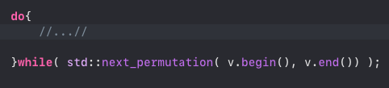
TRAVELLING SALESMAN
Method 1: Brute Force Algorithm
Permutate all the nodes
Calculate the shortest distance
C++ Template
Use vector as its container
Object will be modified and restore at the end
Much faster
Main Steps
Extract the first item as start point
Calculate all the shortest distance
Stop distance calculation when result exceeded the minimum one.

Slide 39
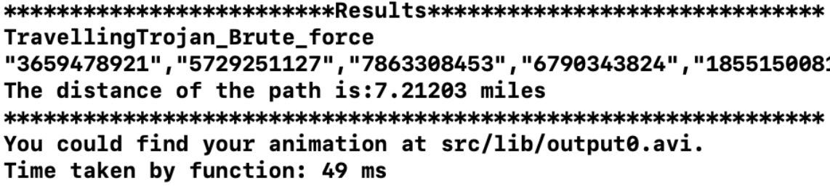
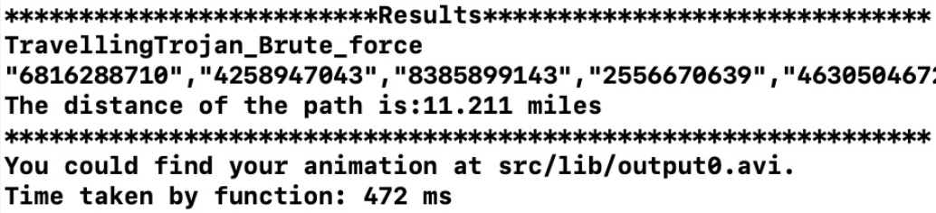
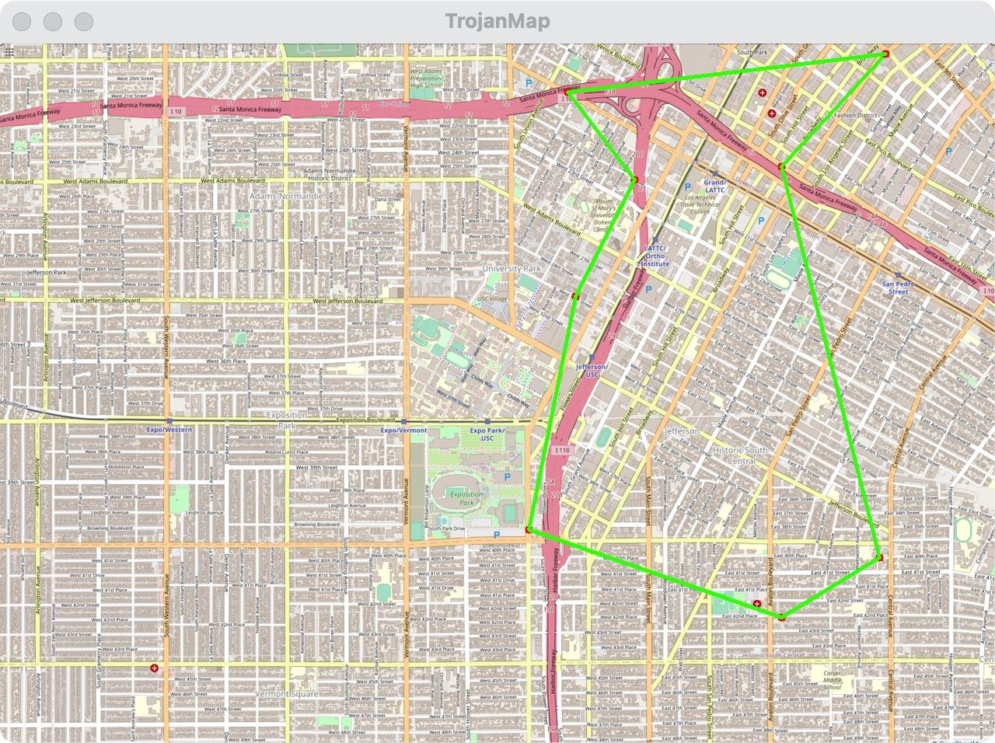

TRAVELLING SALESMAN
Here are some results for Brute Force.
Time: O(n!)
Number of nodes: 8
Number of nodes: 9

Slide 40

TRAVELLING SALESMAN
Method 2: Back Tracking + DP
Permutate all the nodes
Store the distance of previous path
Store all distance from end to end
Calculate the shortest distance
Try this, it’s also fast !!!
Our Permutation Template
When not reach the end, move the pivot (aka. cs ) to the next.
Swap the element you choose with the pivot one.
When reach the end, do something
Why not std::next_permutation ?
We need to do something during the process of creating a permutation.
Early backtracking to accelerate the speed.

Slide 41
TRAVELLING SALESMAN
Our Permutation Template
Repeat the process recursively
Repeat the process recursively
Repeat the process recursively

Slide 42

TRAVELLING SALESMAN
Method 2: Back Tracking + DP
Permutate all the nodes
Store the distance of previous path
Store all distance from end to end
Calculate the shortest distance
Recursive Function
Index mapping table.
Current best result
Distance table
Pivot
Current path solution
Our Permutation Template
When not reach the end, move the pivot (aka. cs ) to the next.
Swap the element you choose with the pivot one.
When reach the end, do something
Why not std::next_permutation ?
We need to do something during the process of creating a permutation.
Early backtracking to accelerate the speed.

Slide 43


TRAVELLING SALESMAN

Slide 44
TRAVELLING SALESMAN QWQ
Here are some results for backtracking dynamic programming algorithm.

Slide 45
TRAVELLING SALESMAN QWQ
Comparison
Brute Forth
Backtracking + DP
S

Slide 46
FIND NEARBY LOCATION

Slide 47

FIND NEARBY
Collect Information
Find out all the nodes with the given attributes
Use count method in std:: set
Binary Search
Sort the useful data
Search right position to insert
Export Data
Pop out the kth data from the container

Slide 48
FIND NEARBY

Slide 49

FIND NEARBY

